Slide 1
Absurdity Unleashed: Exploring the Theatre of the Absurd

Slide 2
Introduction
What is Theatre of the Absurd?
Origins of Theatre of the Absurd
Key Playwrights
Themes and Motifs
Impact on Theatre
Criticism of Theatre of the Absurd
Examples of Theatre of the Absurd
Conclusion
References

Slide 3
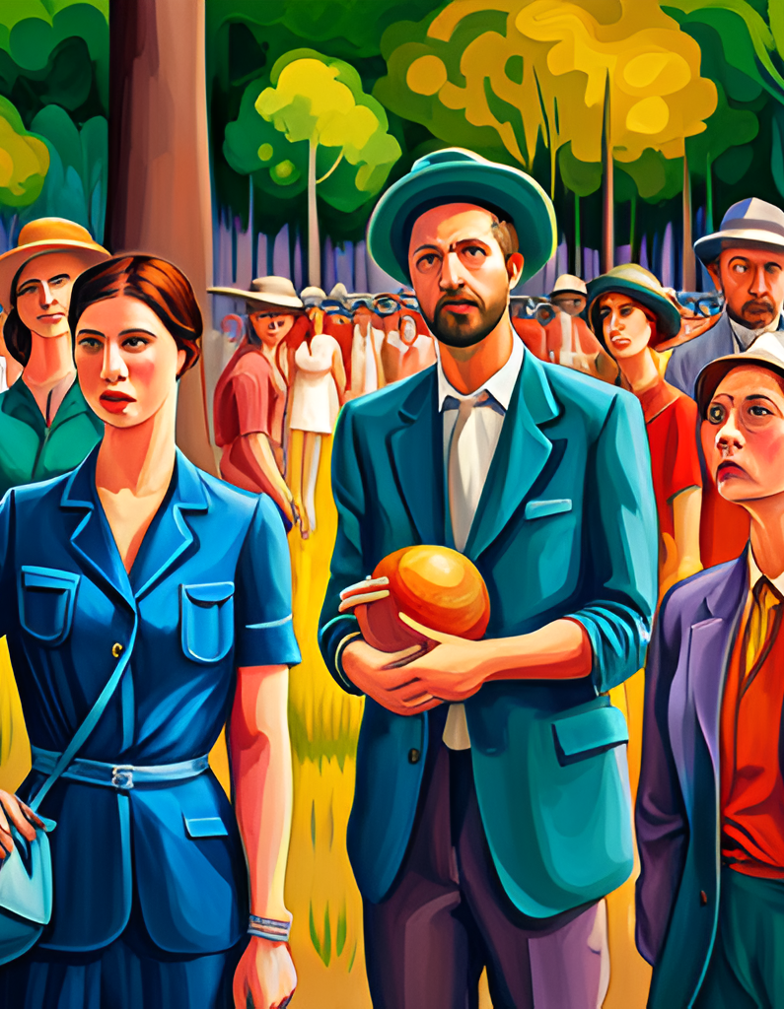
Introduction
Welcome to our presentation on Theatre of the Absurd, a genre of theatre that emerged in the mid-20th century and challenged traditional notions of plot and character development.
Theatre of the Absurd is characterized by its unconventional approach to storytelling, often featuring disjointed dialogue, non-linear plots, and absurd situations. It was born out of a sense of disillusionment with traditional theatre and the world at large, and sought to reflect the chaos and confusion of modern life.

Slide 4
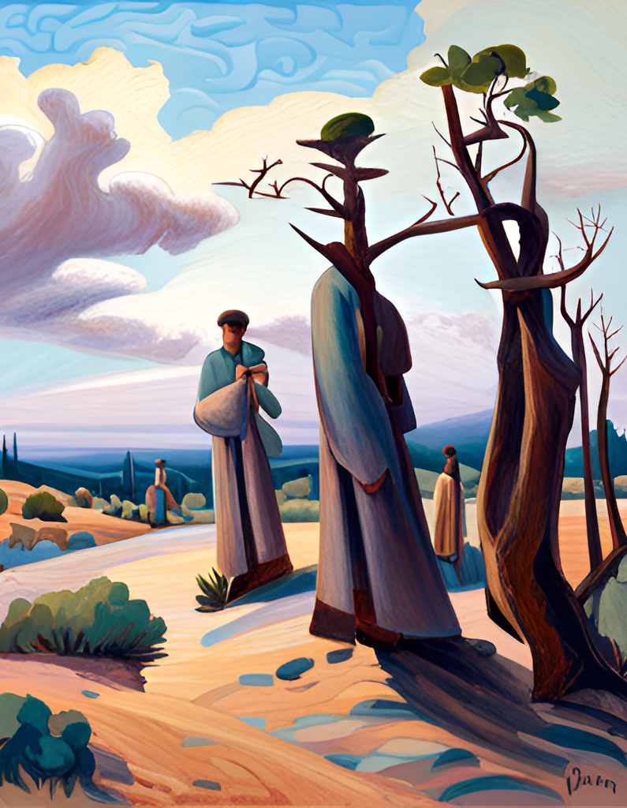
What is Theatre of the Absurd?
Theatre of the Absurd is a form of theatre that emerged in the mid-20th century and is characterized by its rejection of traditional plot and character development. Instead, it focuses on the human condition and the absurdity of existence. This type of theatre often features characters who are trapped in meaningless situations, struggling to find purpose or meaning in their lives.
One of the most famous examples of Theatre of the Absurd is Samuel Beckett's play Waiting for Godot. In this play, two characters wait endlessly for a person named Godot who never arrives. The play has no clear plot or resolution, and instead focuses on the characters' existential crises and their futile attempts to find meaning in an absurd world.

Slide 5
Origins of Theatre of the Absurd
The origins of Theatre of the Absurd can be traced back to the aftermath of World War II, when many artists and intellectuals were grappling with the existential crisis brought on by the war. In Europe, this crisis was compounded by the rise of totalitarian regimes and the threat of nuclear annihilation. Against this backdrop of uncertainty and anxiety, a new form of theatre emerged that rejected traditional narrative structures and embraced the absurdity of human existence.
One of the key influences on Theatre of the Absurd was the philosophy of existentialism, which emphasized the individual's struggle to find meaning in a meaningless world. Playwrights such as Samuel Beckett and Eugene Ionesco drew on this philosophy to create works that reflected the absurdity and futility of human existence. Another important influence was the Surrealist movement, which sought to liberate the unconscious mind and challenge conventional notions of reality. The Surrealists' emphasis on the irrational and the dreamlike can be seen in the surreal imagery and illogical plots of many Absurdist plays.

Slide 6
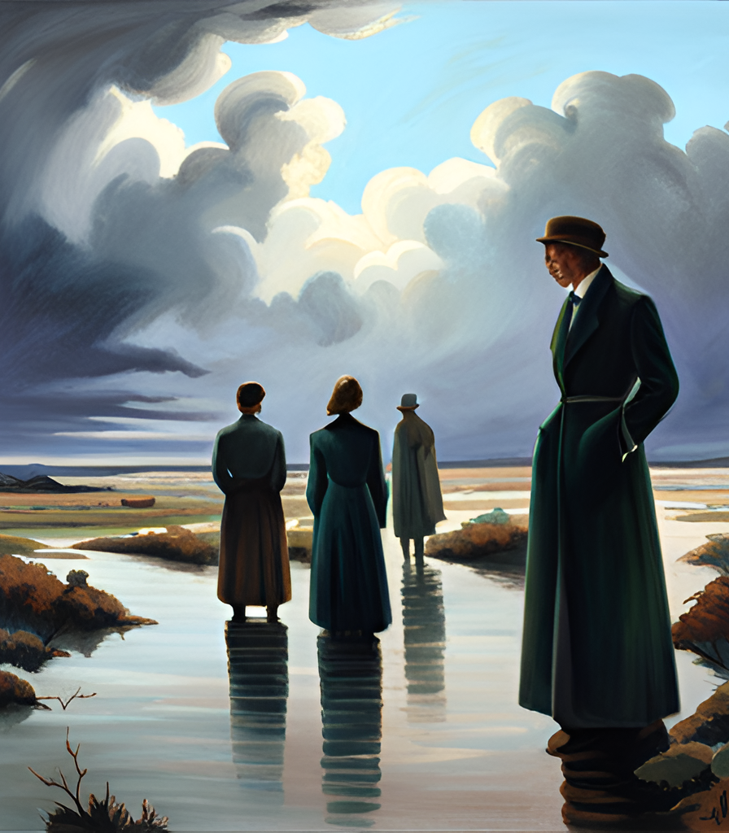
Key Playwrights
Samuel Beckett and Eugene Ionesco are considered two of the most important playwrights associated with Theatre of the Absurd. Their works were characterized by a rejection of traditional plot and character development, and instead focused on exploring the human condition in a chaotic and meaningless world.
Beckett's Waiting for Godot is perhaps the most famous example of Theatre of the Absurd, featuring two characters waiting endlessly for someone who never arrives. Ionesco's Rhinoceros explores the theme of conformity and the loss of individuality in a society overrun by rhinoceroses. Both playwrights used humor and absurdity to challenge conventional notions of theater and provoke thought in their audiences.

Slide 7
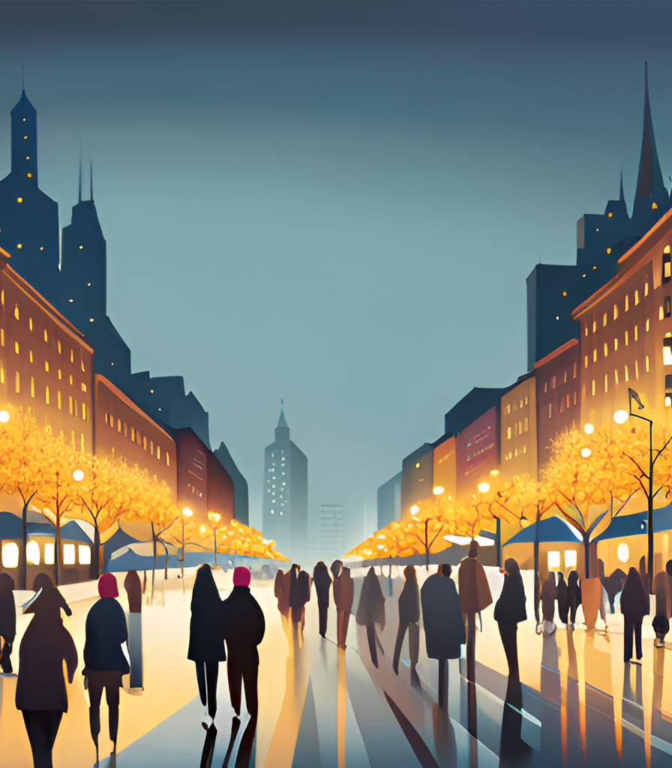
Themes and Motifs
One of the most prominent themes in Theatre of the Absurd is the search for meaning in a chaotic and meaningless world. This theme is often explored through the use of absurd situations and characters who are struggling to find their place in an irrational universe. In plays like Samuel Beckett's Waiting for Godot, the characters are trapped in a cycle of waiting and uncertainty, unable to find any sense of purpose or direction. Similarly, in Eugene Ionesco's Rhinoceros, the protagonist is forced to confront a world where people are turning into rhinoceroses, a surreal and terrifying metaphor for the dehumanization of society.
Another common motif in Theatre of the Absurd is the breakdown of language and communication. Characters often struggle to express themselves or make themselves understood, leading to misunderstandings and confusion. In Beckett's Endgame, for example, the characters' dialogue is fragmented and disjointed, reflecting their inability to connect with each other or the world around them. This breakdown of language highlights the isolation and alienation that many people feel in modern society, where communication has become increasingly complex and fraught with ambiguity.

Slide 8
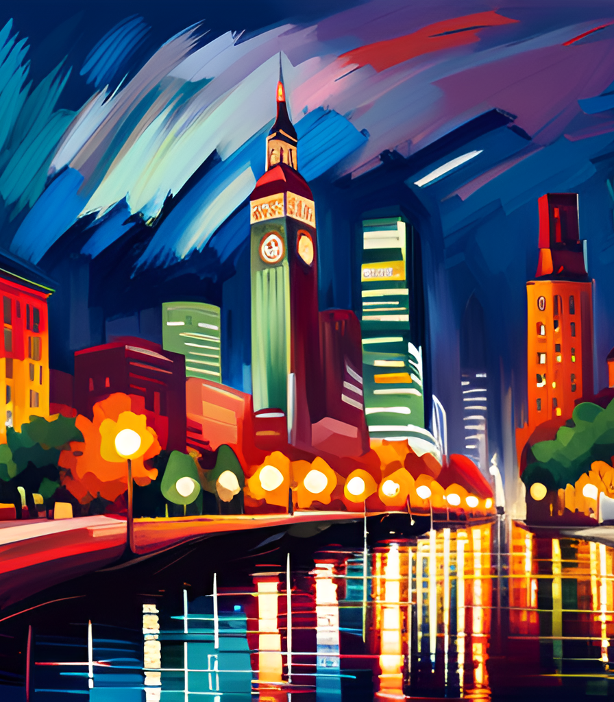
Impact on Theatre
The impact of Theatre of the Absurd on contemporary theatre and performance cannot be overstated. Its rejection of traditional plot and character development has opened up new possibilities for experimentation and innovation in theatre. As theatre scholar Martin Esslin notes, "theatre of the absurd is not a movement in any narrow sense of the word. It is not a school with a fixed set of beliefs, nor a group of playwrights who share a common idiom or approach." Instead, it is a broad and diverse field that continues to inspire new generations of theatre artists.
One of the key ways in which Theatre of the Absurd has influenced contemporary theatre is through its emphasis on existential themes and the search for meaning in a chaotic world. Playwrights such as Samuel Beckett and Harold Pinter have continued to explore these themes in their work, while also pushing the boundaries of form and structure. In addition, the use of non-realistic elements such as absurd humor and surreal imagery has become more commonplace in contemporary theatre, reflecting the influence of Theatre of the Absurd on the art form.

Slide 9
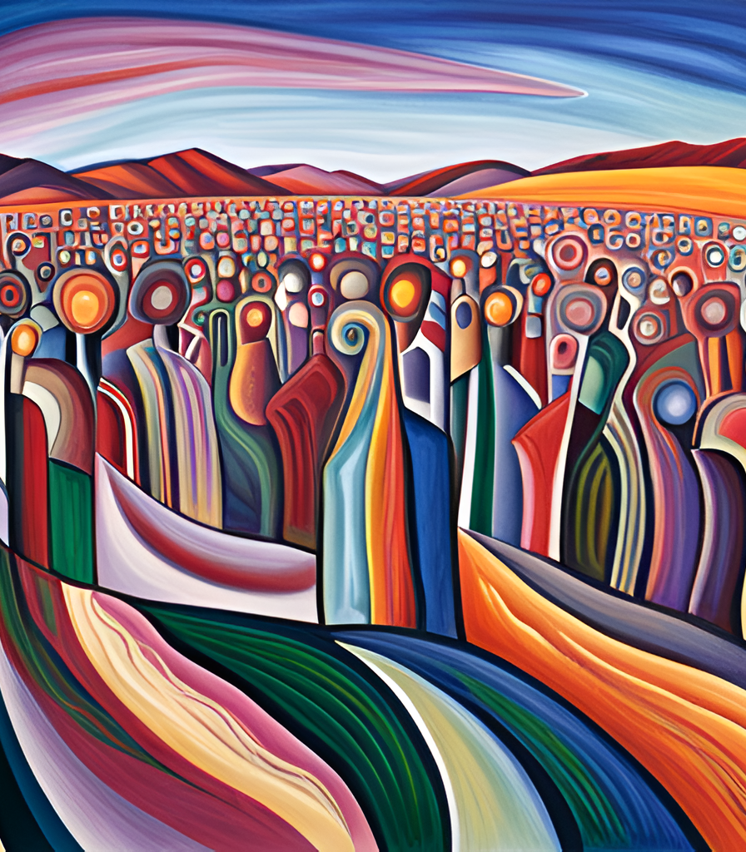
Criticism of Theatre of the Absurd
One of the common criticisms of Theatre of the Absurd is its perceived nihilism. Critics argue that the plays lack a clear moral or philosophical message, and that the characters are often portrayed as hopeless and helpless in a chaotic world. However, proponents of the genre argue that this nihilism is precisely the point - by rejecting traditional narrative structures and character development, Theatre of the Absurd seeks to highlight the absurdity of human existence.
Another criticism of Theatre of the Absurd is its perceived lack of coherence. Critics argue that the plays often seem disjointed and confusing, with little regard for plot or character development. However, supporters of the genre counter that this lack of coherence is intentional - by disrupting our expectations of what a play should be, Theatre of the Absurd forces us to confront the arbitrary nature of language and meaning.

Slide 10
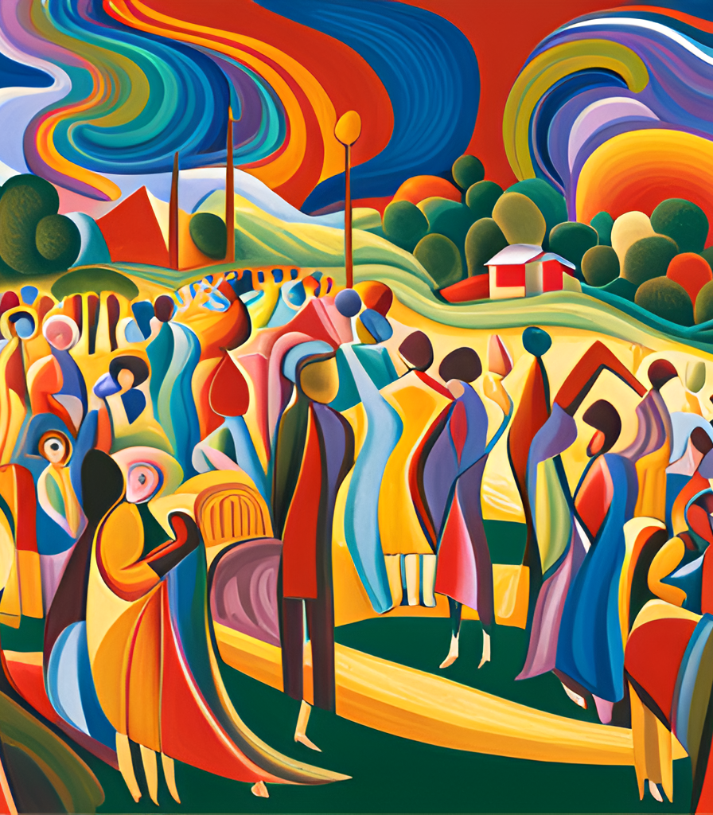
Examples of Theatre of the Absurd
One of the most famous examples of Theatre of the Absurd is Samuel Beckett's Waiting for Godot. The play follows two characters, Vladimir and Estragon, as they wait for a mysterious figure named Godot who never arrives. The play is known for its circular structure and use of repetition, as well as its exploration of themes such as the search for meaning in a meaningless world.
Another important example of Theatre of the Absurd is Eugene Ionesco's Rhinoceros. The play is set in a small French town where the inhabitants are gradually turning into rhinoceroses. The play explores themes such as conformity and the loss of individuality, and is known for its use of absurd humor and surreal imagery.

Slide 11
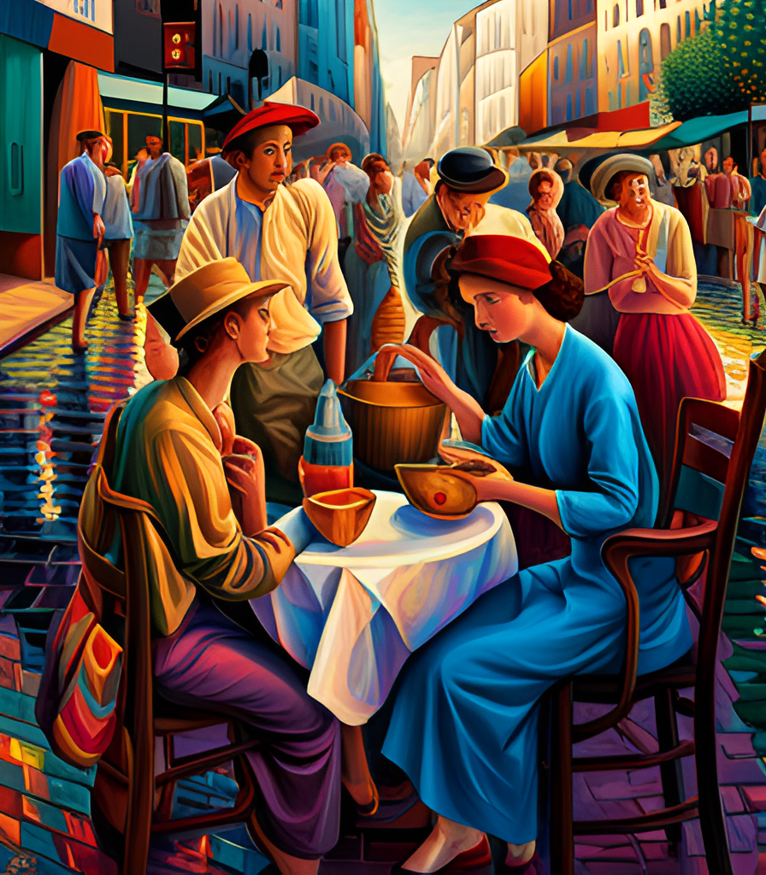
Conclusion
In conclusion, Theatre of the Absurd is a fascinating movement that challenges traditional notions of plot, character, and meaning in theatre. Its key characteristics, such as fragmentation and repetition, create an unsettling yet thought-provoking experience for audiences.
The movement emerged in response to the historical and cultural context of the mid-20th century, which was marked by political turmoil, scientific progress, and existential angst. The works of playwrights like Samuel Beckett and Eugene Ionesco have had a lasting impact on contemporary theatre and performance, inspiring new forms of experimentation and innovation.

Slide 12
References
Adorno, Theodor W. Aesthetic Theory. Routledge, 1984.
Esslin, Martin. The Theatre of the Absurd. Penguin, 2004.
Ionesco, Eugene. Rhinoceros. Grove Press, 1959.
Krauss, Rosalind. The Originality of the Avant-Garde and Other Modernist Myths. MIT Press, 1986.
Martin, Carol. Theatre of the Absurd. Bloomsbury Methuen Drama, 2001.
Beckett, Samuel. Waiting for Godot. Faber and Faber, 1956.

